Slide 1

The Technology Value Stream
Jose Flores
10/24/2025
Assignment: 1.2
Source: The DevOps Handbook: How to Create World-Class Agility, Reliability, & Security in Technology Organizations (Second Edition)

Slide 2
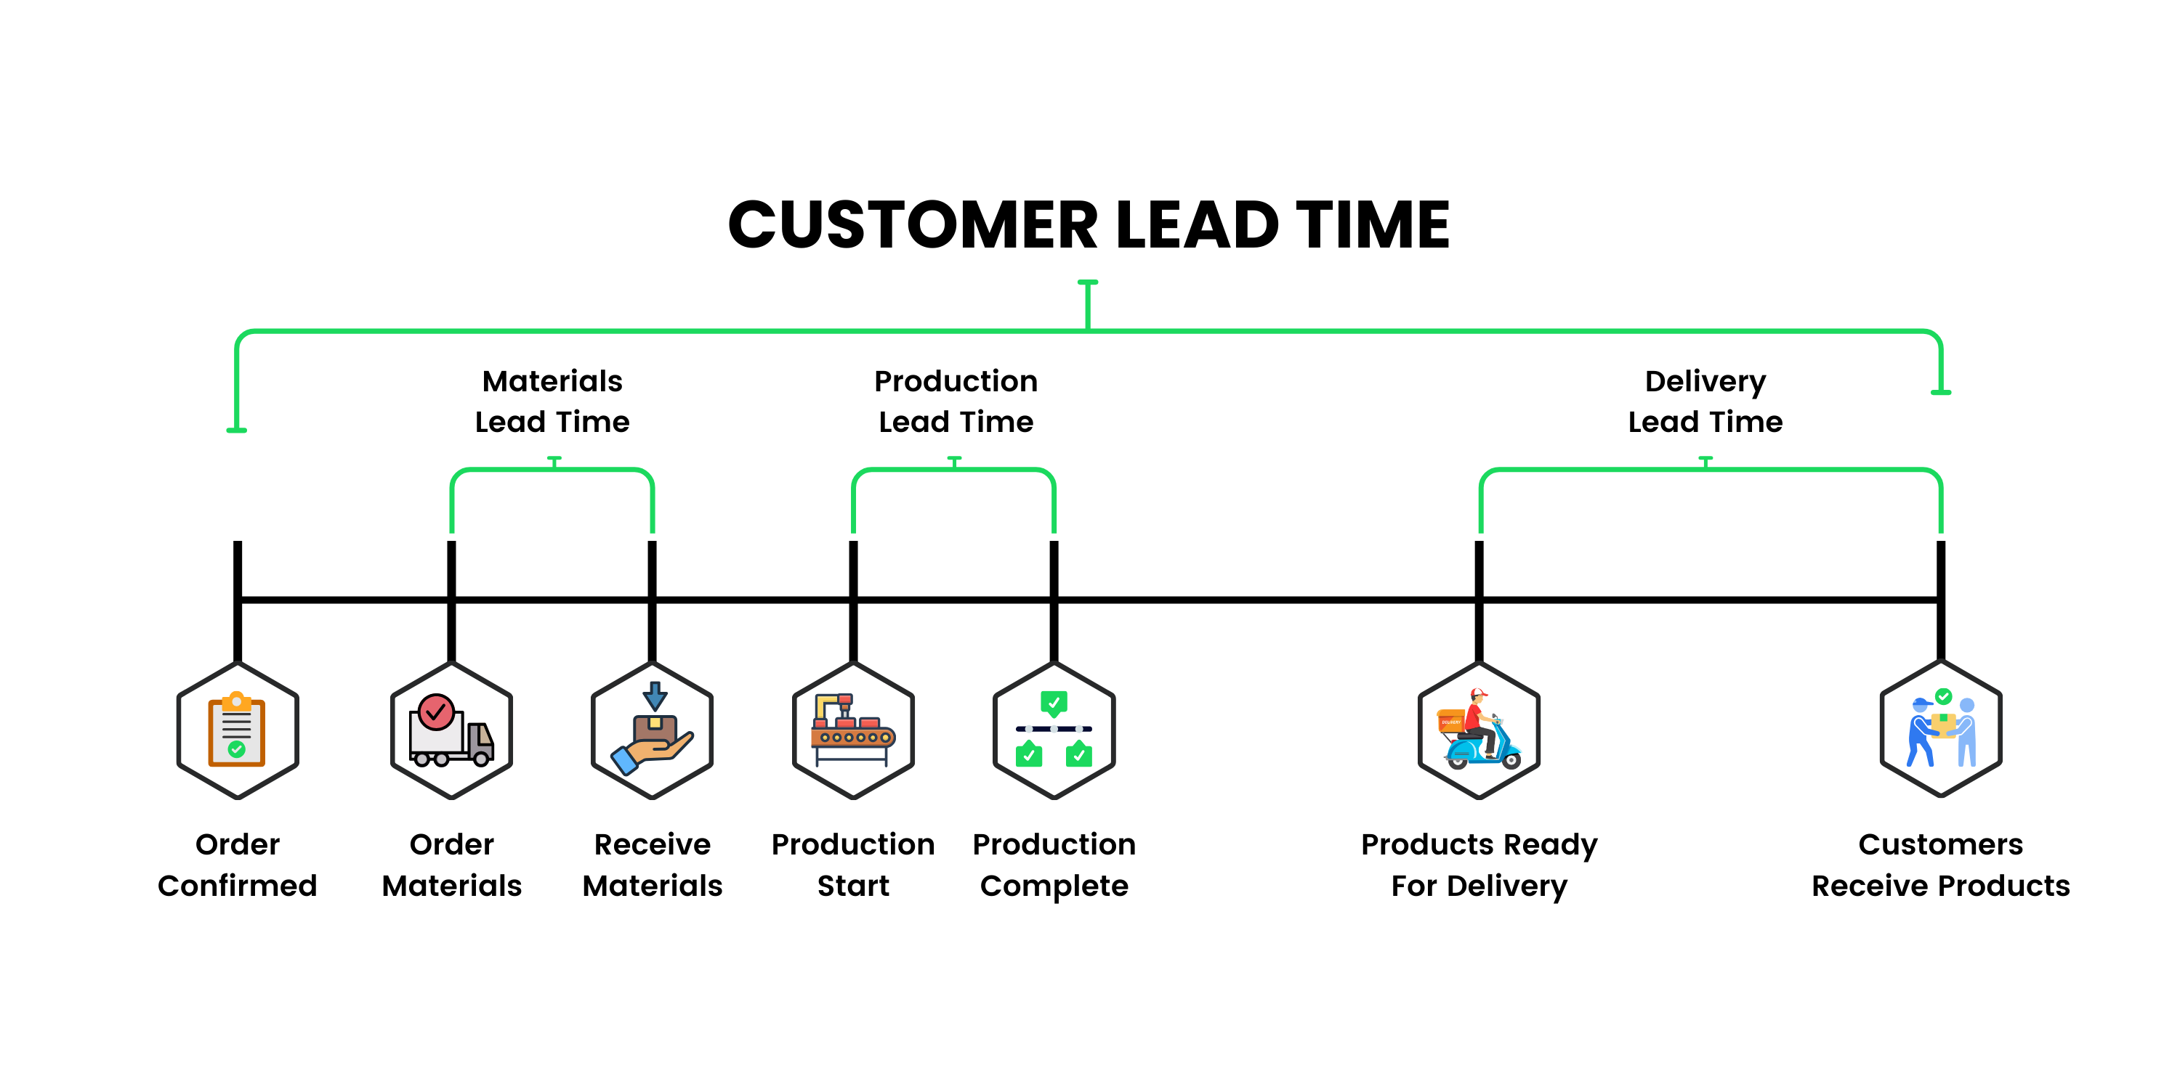
Lead Time vs. Processing Time

Slide 3
Defining Lead Time vs. Processing Time
Lead Time: Total time from a customer request to delivery.
Processing Time: Actual time spent working on the task (doesn’t include waiting).

Slide 4
The Common Scenario: Deployment Lead Times Requiring Months
Challenges:
Big, complex apps
Few test environments
Manual steps slow things down
Results:
Slow delivery
More mistakes
Customers wait longer

Slide 5
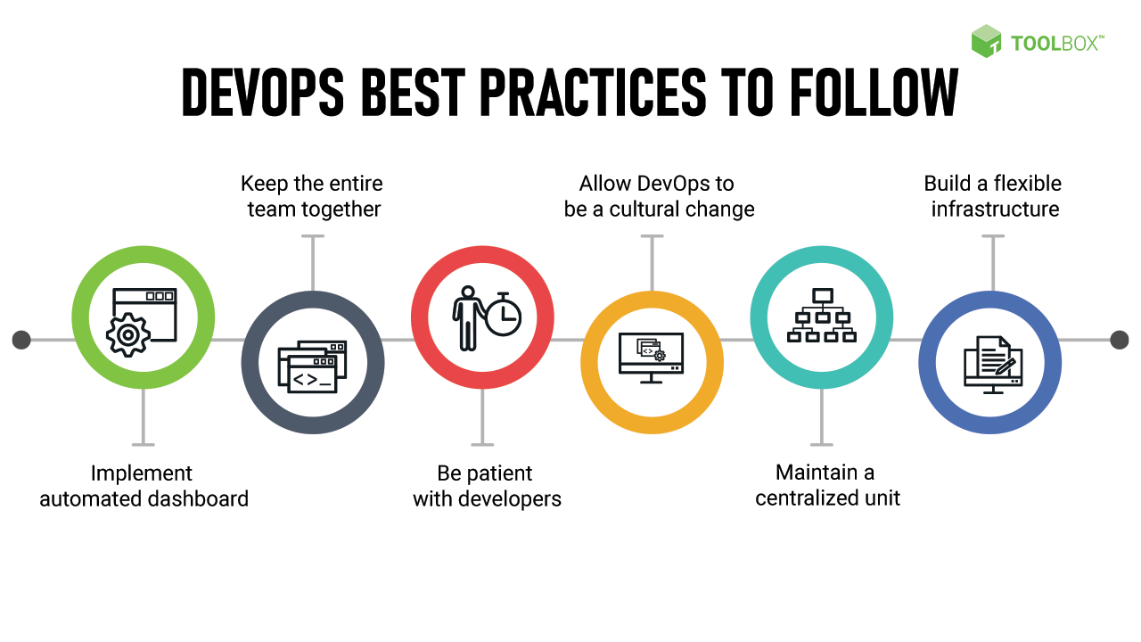
DevOps Goal: Deploy in Minutes, Not Months
Key Practices:
Automate testing and deployment
Use smaller, modular apps
Release small changes often
Benefits:
Faster feedback
Fewer mistakes
Continuous delivery of value

Slide 6
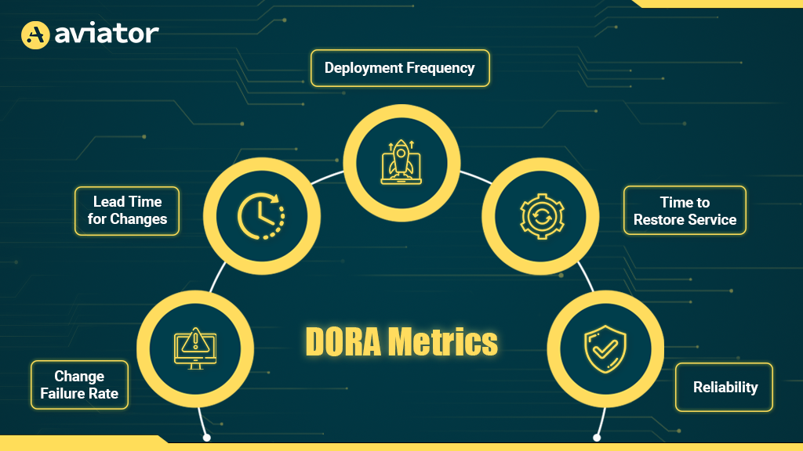
Measuring Success: DORA Metrics
Metrics to Track:
How often updates are released
Time to make changes
How often updates fail
Time to fix problems
Purpose: Helps teams see where they can improve

Slide 7
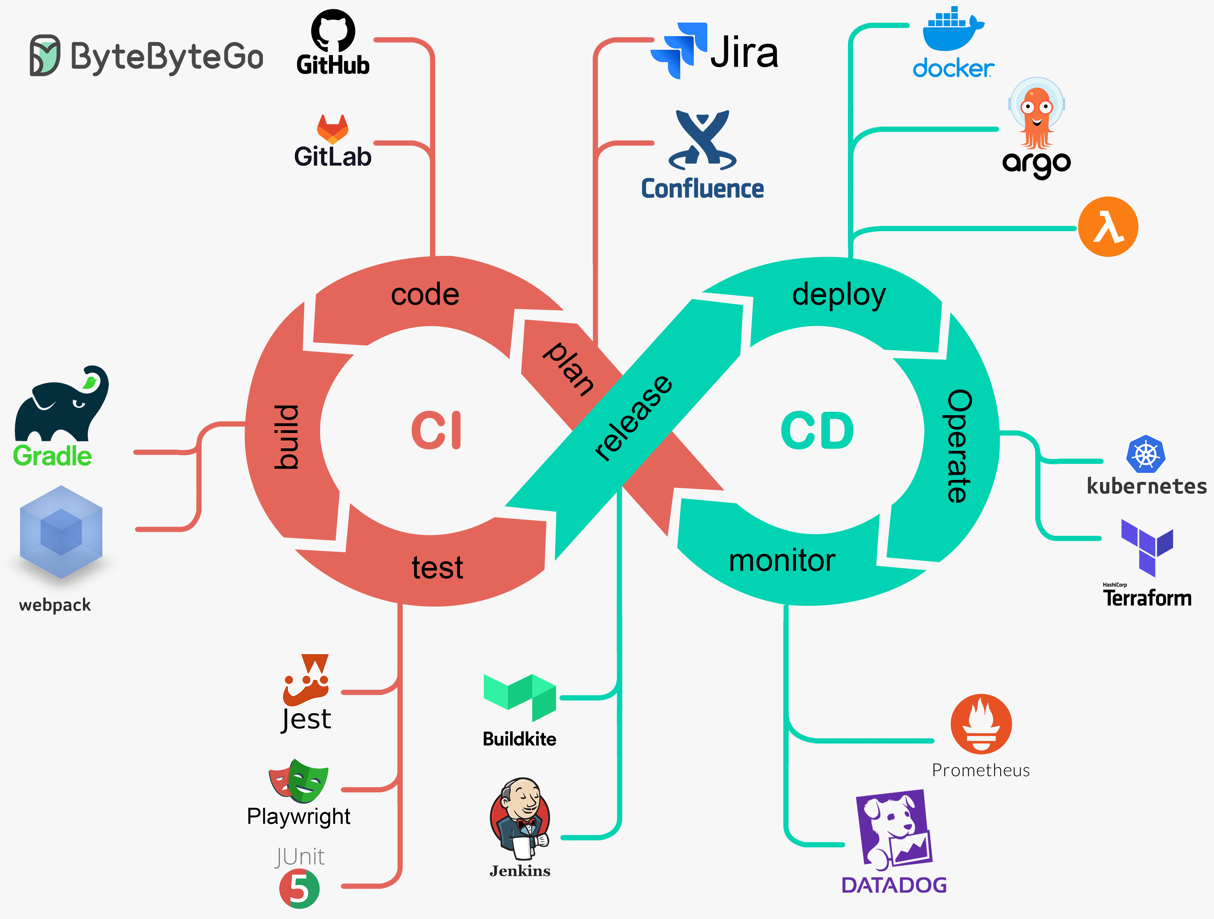
How to Reach Fast Deployments
Recommendations:
Use automated CI/CD pipelines
Break apps into smaller modules
Automate tests and deployments
Work together as a team

Slide 8

Conclusion
Understanding the value stream helps teams deliver software faster and smarter.
Reducing delays and focusing on efficient processes leads to higher quality work.
Start mapping your value stream and look for ways to improve.

Slide 9
References:
“What is CI/CD?” Geeks for Geeks. 21 Aug. 2025. https://www.geeksforgeeks.org/devops/what-is-ci-cd/
Walker, James. “Everything Wrong With DORA Metrics” Aviator. 18 Jan. 2023. https://www.aviator.co/blog/everything-wrong-with-dora-metrics/
“What Is DevOps? Definition, Goals, Methodology, and Best Practices” Spiceworks. 21 Aug. 2021. https://www.spiceworks.com/tech/devops/articles/what-is-devops/

